Slide 1


Digital Logic and circuit lab Spring 24-2025 Section: D Group: 04 Course Code: EEE 3102 Supervised By S M TANVIR HASSAN SHOVON
American International University-Bangladesh(Aiub) Faculty of Science and Technology

Slide 2
Group Members
DEBASHIS KUMAR DAS (23-50953-1)
BASUDEB KUNDU (23-50856-1)
MD. OMAR FAROQUE BHUIYAN (23-50048-1)
ARGHA GHOSH (23-50804-1)
Tauhid Sarker (23-52773-2)

Slide 3

Introduction
This project presents the design of an obstacle avoiding car using an arduino uno R3. The car uses an ultrasonic sensor mounted on a servo motor to detect obstacles ahead and IR sensors for close-range side detection. Based on sensor input, the arduino controls the movement through an L298N motor driver, adjusting direction to avoid collisions. This low-cost setup demonstrates basic autonomous navigation and real-time decision-making in robotics.

Slide 4
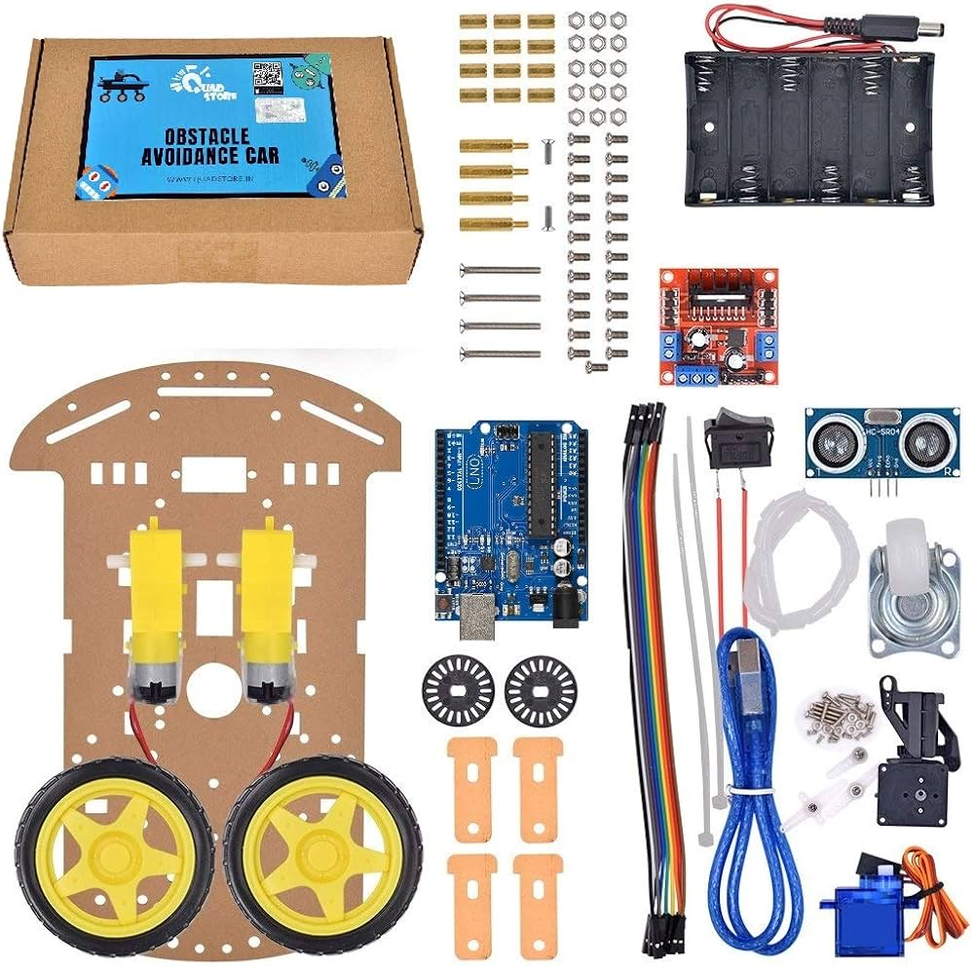
Components
1. Arduino Uno R3
2. Infrared Obstacle Avoidance IR Sensor Module
3. HC-SR04 Plus Ultrasonic Sonar Sensor
4. Servo Motor Micro SG90 180
5. L298N H-Bridge Dual Motor Driver
6. 6v 100 RPM DC Gear BO Motor
7. Yellow Plastic Mag Wheel Soft Tire
8. Breadboard small
9. Battery

Slide 5
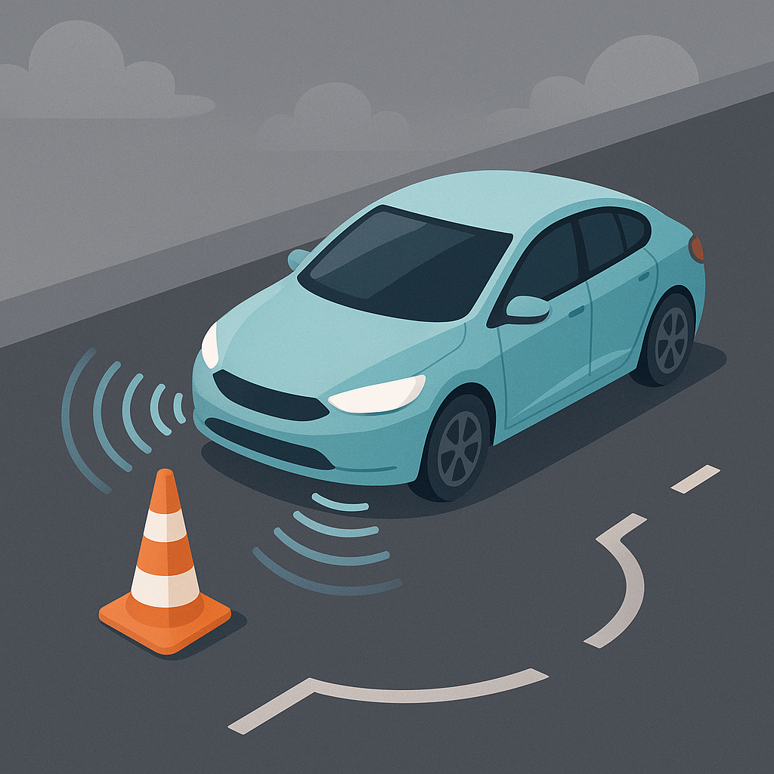
Components Description
This project is an autonomous Obstacle Avoiding Car built using an Arduino Uno R3 microcontroller. The vehicle is designed to navigate its environment by detecting and avoiding obstacles using a combination of infrared (IR) and ultrasonic sensors.
Arduino Uno R3 serves as the brain of the system, processing sensor inputs and controlling motor outputs.
HC-SR04 Plus Ultrasonic Sensor detects objects in front of the car by measuring distance via sound waves, enabling accurate forward obstacle detection.
Infrared Obstacle Avoidance IR Sensor Module provides short-range object detection on the sides to assist in steering decisions.
SG90 Micro Servo Motor rotates the ultrasonic sensor to scan the surroundings and determine the optimal path.
L298N H-Bridge Dual Motor Driver is used to control the direction and speed of the 6V 100 RPM DC Gear BO Motors.
The motors drive the car forward or backward and allow turning by differential motor control, with Yellow Plastic Mag Wheels providing traction and mobility.
A small breadboard is used for circuit prototyping and easy connection of sensors and modules.
Power is supplied via a battery pack, enabling wireless and mobile operation.
This setup allows the robot car to move autonomously, detect obstacles, and change direction in real-time, making it ideal for basic robotics and embedded systems experimentation.

Slide 6
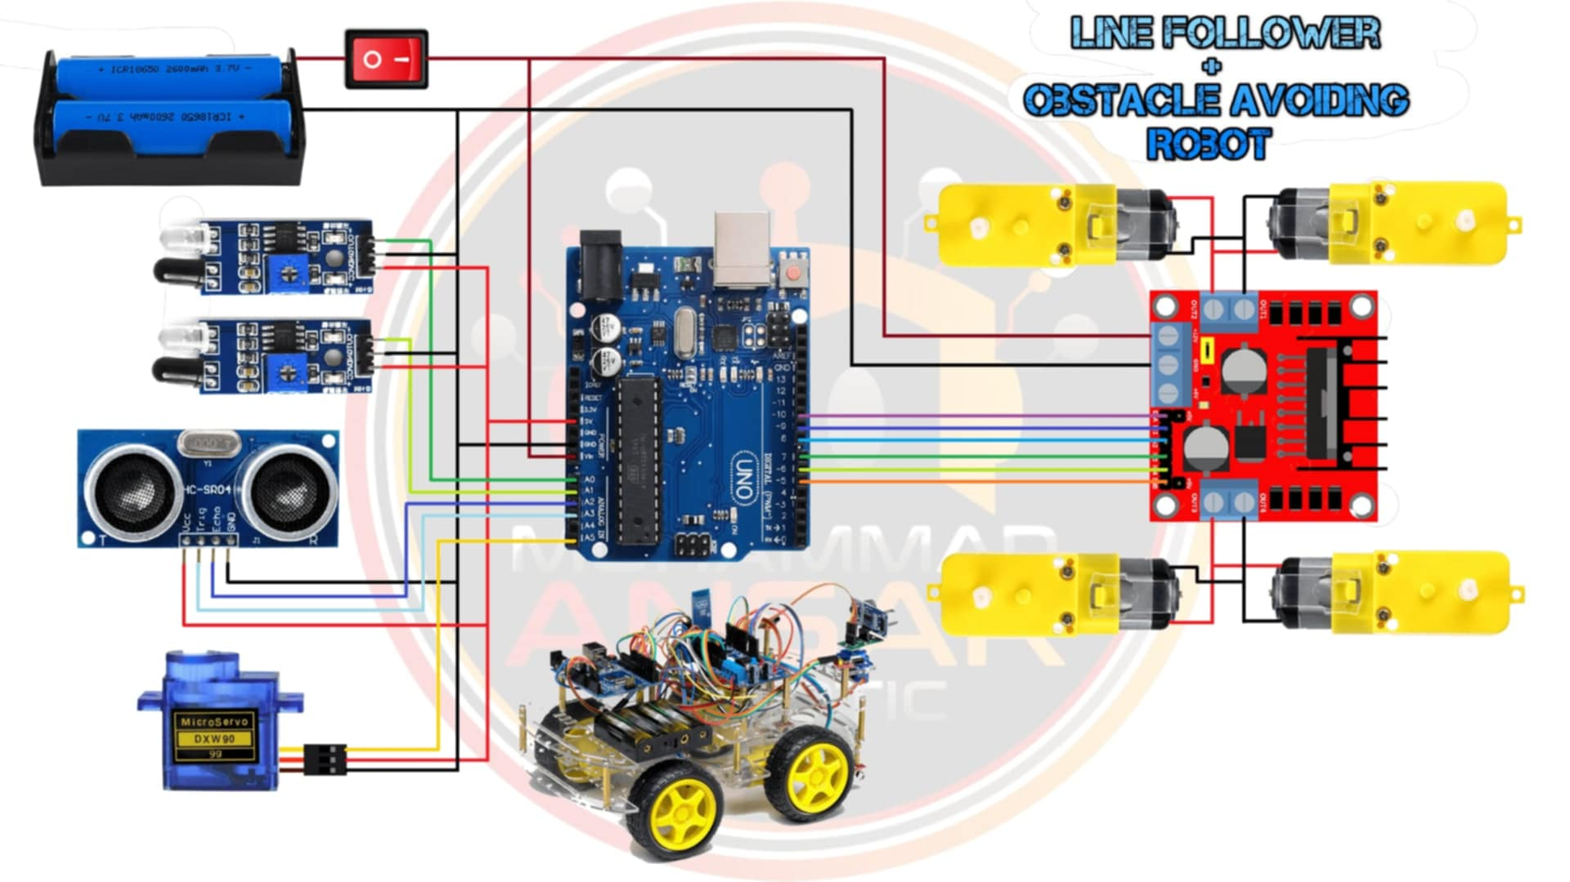
CIRCUIT DESIGN

Slide 7
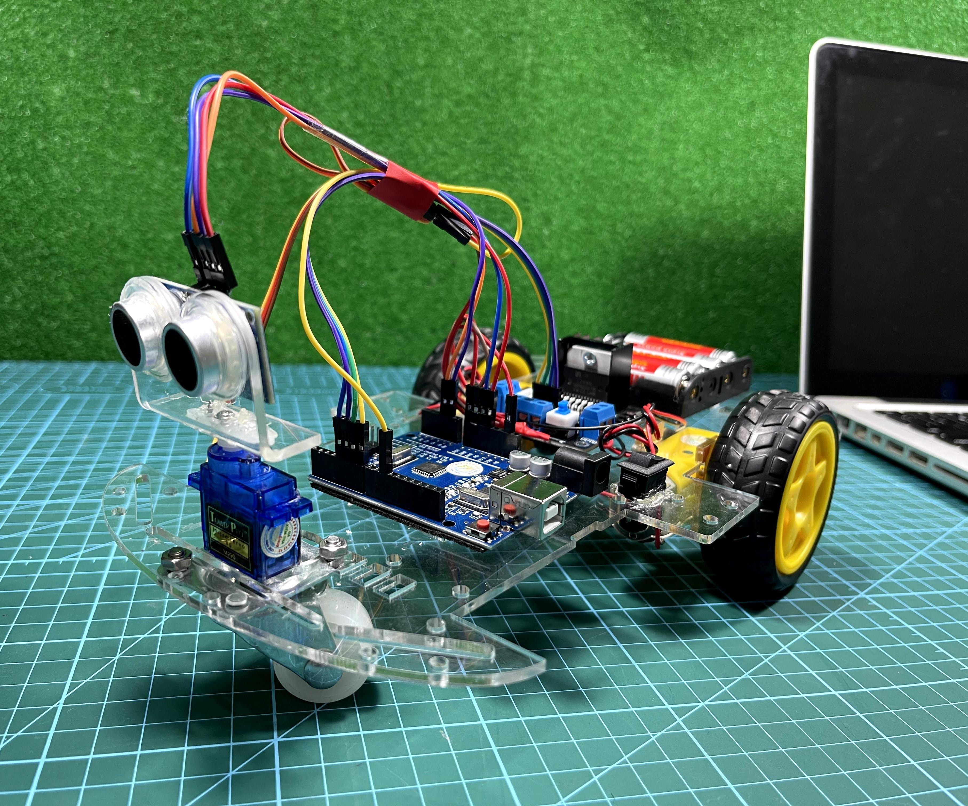
How it works
1. Brain: Arduino Uno R3
Controls everything. Gets sensor input, decides direction, sends signals to motors.
2. Eyes: IR Sensor & HC-SR04 Ultrasonic Sensor
IR Sensor: Detects nearby obstacles (close range, like walls).
HC-SR04: Measures distance in front to detect far obstacles.
Together, they help the car detect obstacles ahead or on the sides.
3. Limbs: Motors & Wheels
DC Gear BO Motors (x2) + Wheels: Drive the car forward/backward.
L298N Motor Driver: Powers and controls the motors using signals from Arduino.

Slide 8
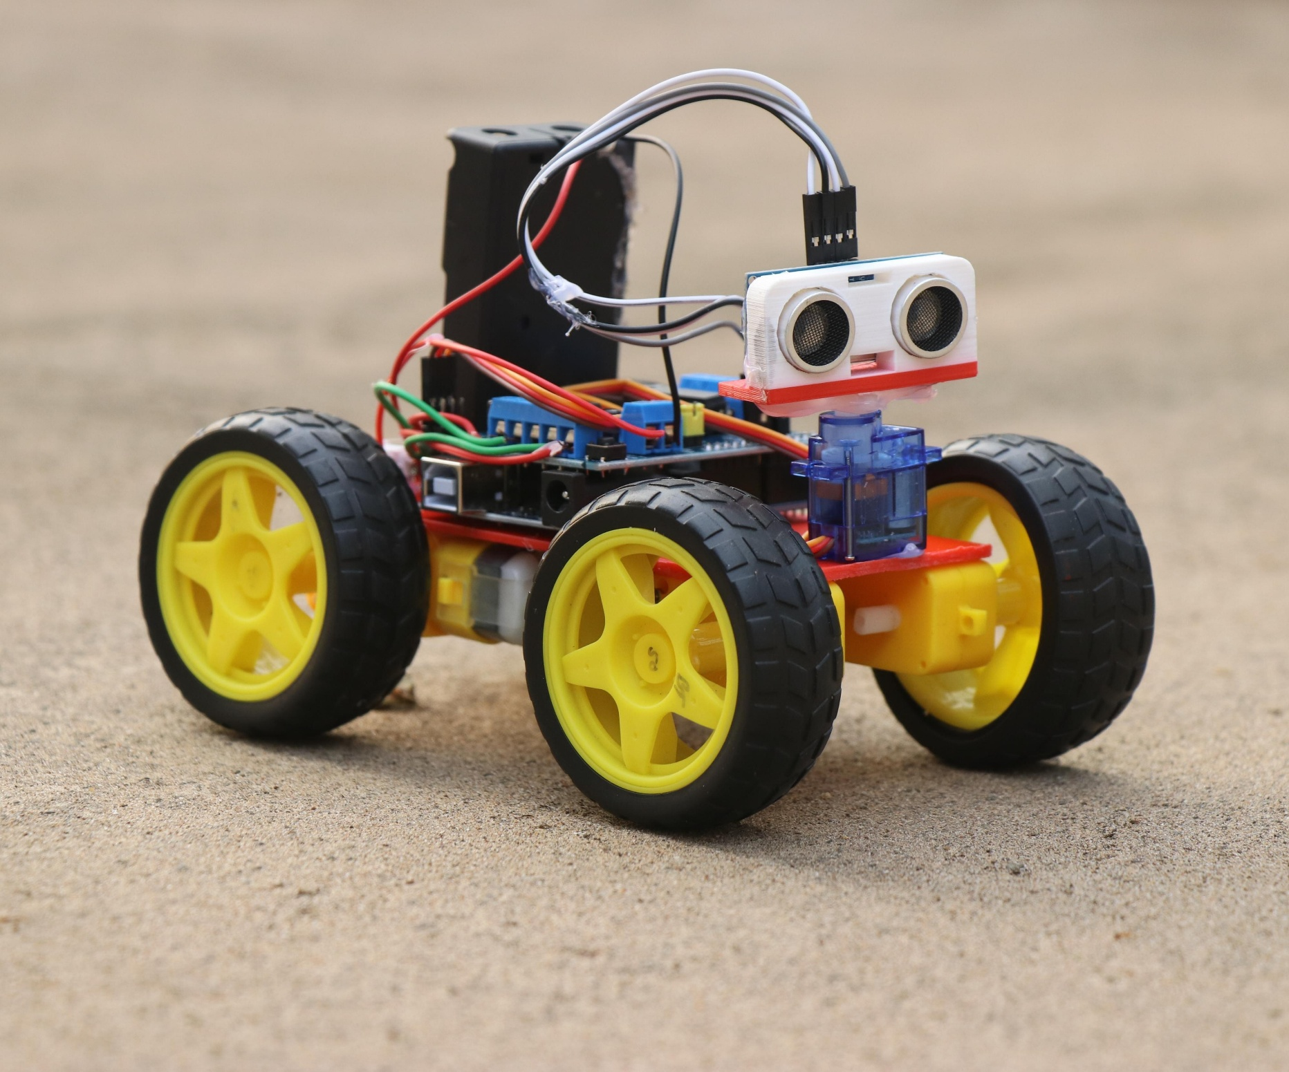
HOW IT WORKS
4. Head/Turret: Servo Motor + HC-SR04
Mount the ultrasonic sensor on the SG90 servo.
This allows the sensor to rotate left/right, so it can scan surroundings.
5. Power: Battery
Powers the motors and Arduino (via VIN pin or motor driver).
6. Breadboard & Wires
Connect components without soldering.
Logic:
Move forward by default.
Use IR sensor or ultrasonic to detect obstacle.
If obstacle detected:
Stop.
Use servo to rotate ultrasonic left and right.
Measure distances.
Turn toward the side with more space.
Repeat.

Slide 9
CONCLUSION
Motor Control L298N driver manages motor direction and speed effectively
Autonomous Navigation Car moves independently, avoiding obstacles using sensors.
Dynamic Scanning: Servo motor enables side-to-side ultrasonic scanning for optimal path
Sensor Integration Combined IR and ultrasonic sensors for short and long-range detection.

Slide 10
THANKS
DO YOU HAVE ANY QUESTIONS

